Slide 1
Game Time: Project Week
Day 24
Sep 7, 2016

Slide 2
Project Week Overview

Slide 3
Yay!
You made it!!!

Slide 4

Project Week! (This Week)
Today’s Class:
Divide into groups
Begin researching APIs
Outline project ideas
Submit Project Proposal for Approval
Initial Design work
Next Class:
Hardcore Development
Instructor + TA Workshops
Saturday’s Class:
Hardcore Development

Slide 5
Project Week (Next Week)
Next Week (M/T):
Interview Questions (Class Lecture)
Hardcore Development
Next Week (W/Th)
Debug Work (Class Lecture)
Hardcore Development
Presentation Prep
Saturday’s Class:
Presentations!

Slide 6
The Great Push
Be serious about project week!
Use this as an opportunity to push yourself and prove what you know.
Because you DO KNOW shiz.

Slide 7
Teams

Slide 8
Groups
Team #1
Freddy / Evan / Armando
Team #2
Allie / Del / Vis
Team #3
Brandon / Marcus / Tuan
Team #4
Christine / Saidi / Nigel
Team #5
Kelana / Maria / Tatiana
Team #6
Michael / Sam / Travis
Team #7
Rebecca / Kristin / Eric

Slide 9
Task

Slide 10
Coding Requirements
Must uses at least two APIs
Must use AJAX to pull data
Must utilize at least one new library or technology that we haven’t discussed
Must have a polished frontend / UI
Must meet good quality coding standards (indentation, scoping, naming)
Must NOT use alerts, confirms, or prompts (look into modals!)
Must have some sort of repeating element (table, columns, etc)
Must use Bootstrap or Alternative CSS Framework
Must be Deployed (Heroku or Firebase)
Must have User Input Validation

Slide 11
Coding – Nice To Haves
Utilize Firebase for Persistent Data Storage (Consider this basically a requirement).
Mobile Responsive
Use an alternative CSS framework like Materialize

Slide 12
Presentation Requirement
You will also be responsible for preparing a 10 minute presentation.
This will be a formal presentation.
One in which you explain in detail:
Your overall application’s concept
The motivation for its development
Your design process
The technologies you used (and briefly how they work)
A demonstration of its functionality
Directions for future development
Treat the presentation seriously!
Talking intelligently about tech > doing tech sometimes.

Slide 13
Be Glam for the Camera
All presentations will be recorded…
So treat it seriously!
These can be great portfolio pieces if you invest the time.

Slide 14
Metrics

Slide 15
Metrics
Concept
Design
Functionality
Collaboration
Presentation

Slide 16
Awards Yay!
Most Awe-Inspiring
Most Useful
Most Creative
Best Use of Tech
Best UI/UX
Most Hilarious
Most Disruptive
Most Socially Conscious

Slide 17
API Suggestions

Slide 18
API Suggestions
Stick to APIs that do all of the following:
Allows CORS
Simple or no authentication
JSON response returned
Well documented

Slide 19
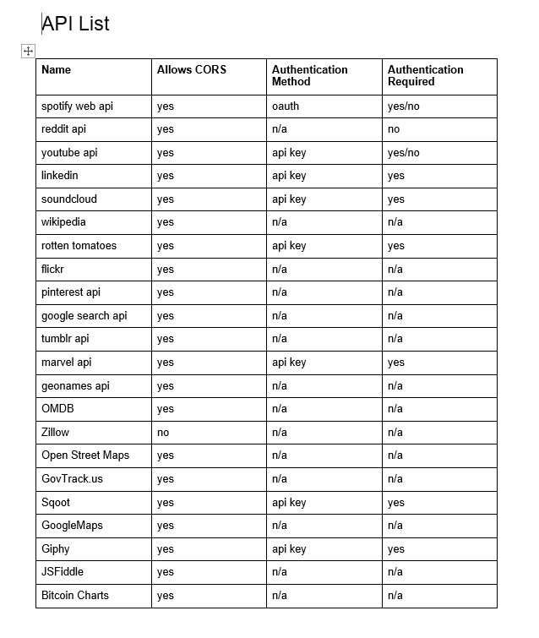
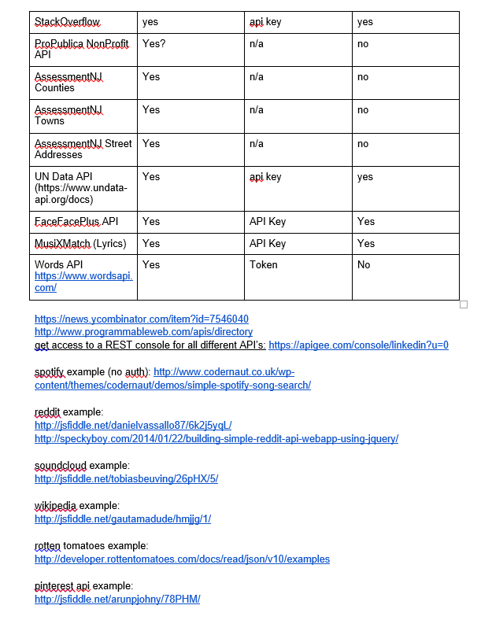
API Suggestions

Slide 20
Tools

Slide 21
Collaboration is Critical!
Steering a project with remote developers like this one can be challenging.
Consider using the following tools…

Slide 22
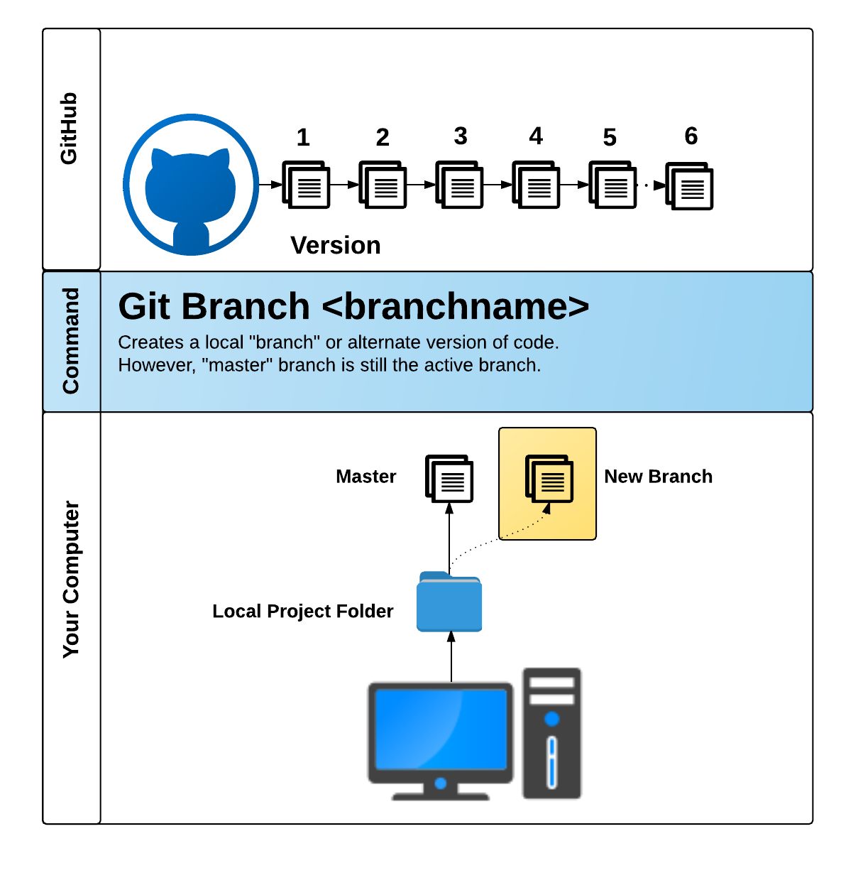
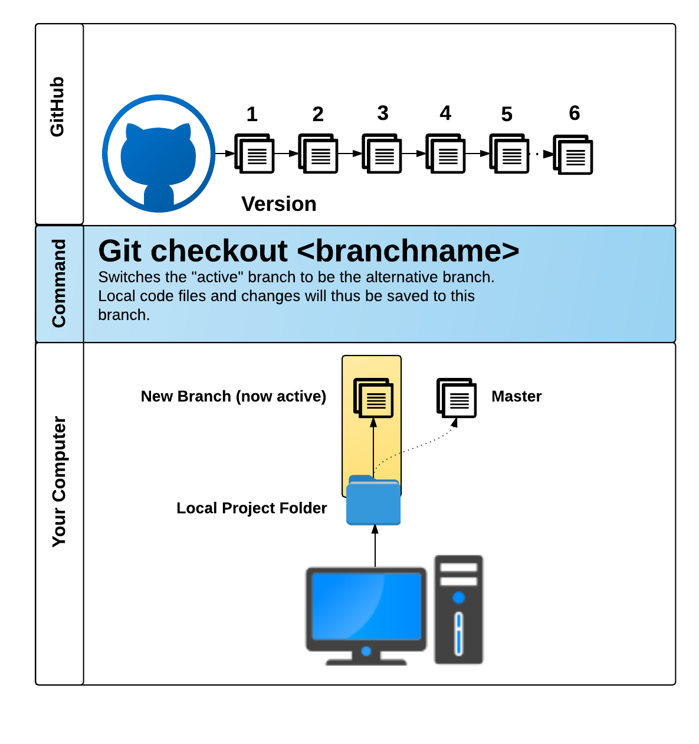
GitHub Pull Requests
GitHub Pull Requests are a great way to “combine” code when multiple users are working on the same files.
We’ll show you how to use this feature in the next class.

Slide 23
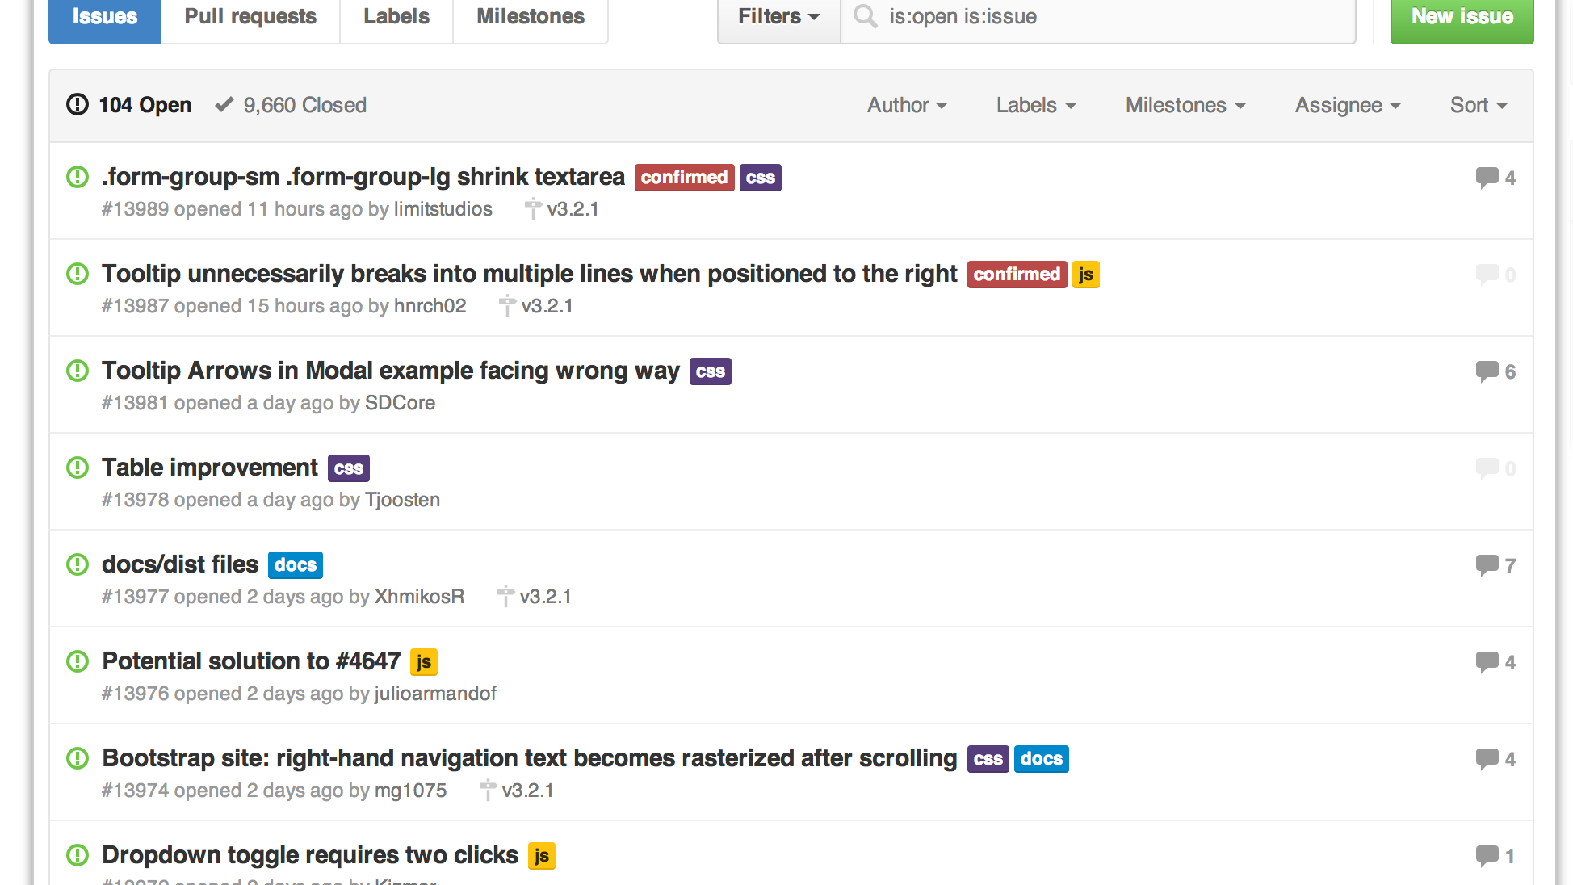
GitHub Issues
GitHub Issues are a great way to keep track of bugs, feature requests, etc.

Slide 24
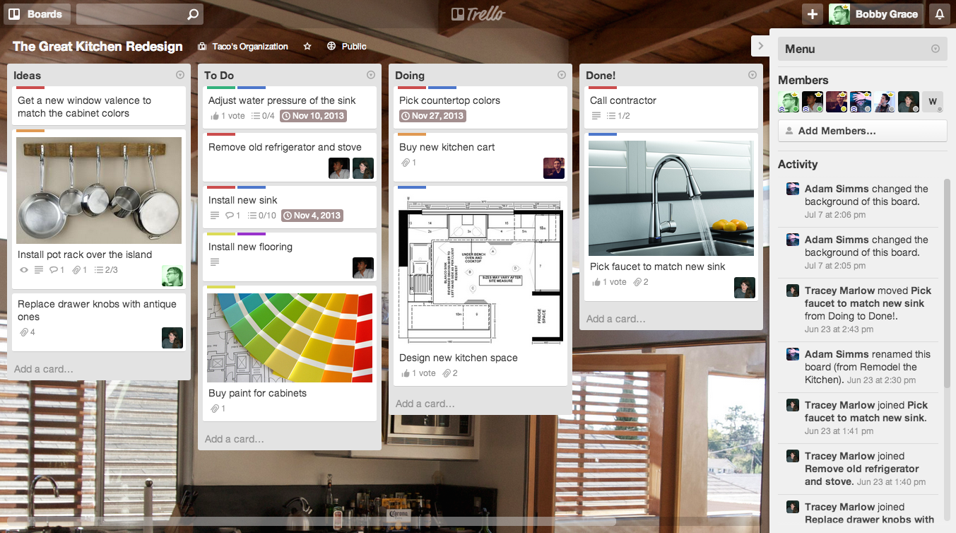
Trello
Trello is a great project management tool for creating to-do lists and communicating updates.

Slide 25
Example Project Ideas

Slide 26

Event Searcher
Users type in the name of their favorite sporting team.
Then using the SeatGeek API, your web application points them to the next game and location where the team is playing.
The web application also provides them a link to Ebay where they can purchase memorabilia associated with the team.

Slide 27

UN Data API
Use the Unofficial UN Data API to search a user specified country’s health records.
Then use a secondary data source (Google Maps, Flickr, YouTube, etc.) to provide additional context or data.
Examples: Per Capita Govt Expenditures on Health, # of Physicians, Deaths due to HIV, Malaria Cases etc, low birth weight newborns

Slide 28

Facial Recognition
Use the Face++ API
Allow users to provide a URL link to a facial image then provide viewers with information on the image’s gender, race, whether they are wearing glasses, and their age
Use Firebase to update ALL users of the site about the current search

Slide 29
Or…
Just do your own thing.
Be creative! Be ambitious!

Slide 30
Today’s Focus

Slide 31
By End of Day - Today
Brainstorm possible ideas
Begin API Research
Create an initial draft / sketch of the final design
Create a short 1 page proposal listing out each of the following:
Project Title
Team Members
Project Description
Sketch of Final Product
APIs to be Used
Rough Breakdown of Tasks

Slide 32
Questions

